Slide 1

MINI Project Presentation On WildDiscover: AI-Powered Wildlife & Landmark Explorer
21R21A6686 K. Mithun Reddy
21R21A6692 K. Mounesh
22R25A6695 K. Harsha
21R21A66C7 V. Satwik
Under the Guidance of
Mrs. G. UMAMAHESWARI
Assistant Professor
Department of Artificial Intelligence & Machine Learning
Batch No. B14
Slide 1

Slide 2
Contents
Abstract
Introduction
Literature Survey
Existing System
Disadvantages of Existing System
Proposed System
Architecture
Implementation(Sample code)
Result and Discussion
References
Batch No. B14
Slide 2

Slide 3
Abstract
WildDiscover is an innovative app designed to identify wildlife, monuments, historic persons, and landscapes. It uses a hybrid approach by integrating multiple free APIs, including the Pollinations API, Animal API from API Ninjas, Google Vision API, and Wikipedia API, to deliver accurate and informative results. The app offers seamless offline and online functionality—providing identification support even without internet access and enriching results with detailed online data when connected. With a user-friendly interface and reliable performance, WildDiscover delivers a rich and educational experience for nature enthusiasts and travelers, making it a valuable companion for exploring the world’s wonders.
Batch No. B14
Slide 3

Slide 4

Introduction
WildDiscover is a mobile and web-based application designed to help users identify wildlife, monuments, and landscapes in real time. By combining user-friendly design with powerful online data sources, the app provides quick and informative results to enhance exploration experiences. It integrates various public APIs to fetch accurate and detailed information, enabling users to learn more about their surroundings. With support for both online and offline usage, WildDiscover is an ideal companion for nature lovers, travelers, and outdoor enthusiasts seeking knowledge on the go.
Batch No. B14
Slide 4

Slide 5
Literature Survey
Authors | Title of the Paper | Techniques Used | Advantages | Disadvantages
Carvajal, Garcia-Colon | Detection of Wildlife Animals using Deep Learning Approaches: A Systematic Review | Deep learning models, automatic camera traps | DL boosts wildlife monitoring accuracy. | Need for diverse datasets to improve robustness.
Islam, Valles | Animal Species Recognition with Deep Convolutional Neural Networks from Ecological Camera Trap Images | Deep CNNs | DL automates species identification with high accuracy. | More research needed for diverse environments and challenging conditions.
Hossain et al. | Deep learning for wildlife conservation and habitat monitoring: A comprehensive review | CNNs, RNNs | DL enhances monitoring capabilities but faces interpretability challenges. | Need for standardized datasets and increased collaboration for model development.
Abdollahi | Identification of Medicinal Plants in Ardabil Using Deep Learning | DL, Image processing | AI effectively classifies medicinal plants. | Further research needed to validate the model's performance on diverse plant species and improve interpretability.
Batch No. B14
Slide 5

Slide 6
Existing System
Google Lens:
Google Lens is a widely used tool for general object and landmark recognition. It is fast and supports multiple categories like text, plants, and monuments. However, it is not specialized for wildlife identification and requires an internet connection, offering no offline functionality.
Merlin Bird ID:
It is developed by the Cornell Lab of Ornithology, is focused solely on bird species identification. It is accurate and supports offline use, which is a major strength. However, it does not recognize landscapes, monuments, or animals outside of birds.
PlantNet:
It is an app aimed at plant species identification using crowdsourced data. It is easy to use and beneficial for botany enthusiasts. Its limitation is that it only covers plants, with no support for wildlife, landscapes, or monuments.
iNaturalist:
iNaturalist is a community-powered platform for identifying both plants and animals. It uses AI to assist recognition and benefits from a large user base. However, it depends heavily on an internet connection and community input, which can delay accurate identification.
Batch No. B14
Slide 6

Slide 7
Disadvantages of Existing System
Require Internet Connectivity – Most systems like iNaturalist and Google Lens need active internet for identification.
Limited Offline Support – Only a few like Merlin Bird ID and Seek by iNaturalist offer offline functionality, and that too is restricted.
Single-Domain Focus – Apps like PlantNet and Merlin are limited to plants or birds only, not general wildlife or landmarks.
Lack of Custom AI Models – Existing systems rely on fixed models/APIs, offering limited customization or tuning for specific use cases.
Slow or Crowdsourced Identification – Platforms like iNaturalist depend on user community input, delaying results.
No Multi-Category Integration – None offer combined identification of wildlife, monuments, landscapes, and historical figures in one app.
Batch No. B14
Slide 7

Slide 8
Proposed System
Hybrid AI Approach – Offline AI (EfficientNetV2 + TensorFlow Lite) + Online APIs (PlantNet, Google Vision, Wikipedia).
Offline & Fast Recognition – Identifies wildlife, monuments and landscapes without internet.
Seamless API Integration – PlantNet (wildlife data), Google Vision (image recognition), Wikipedia (detailed info).
Key Advantage – Combines AI-powered offline & online recognition for an accurate, fast, and cost-efficient experience.
Batch No. B14
Slide 8

Slide 9
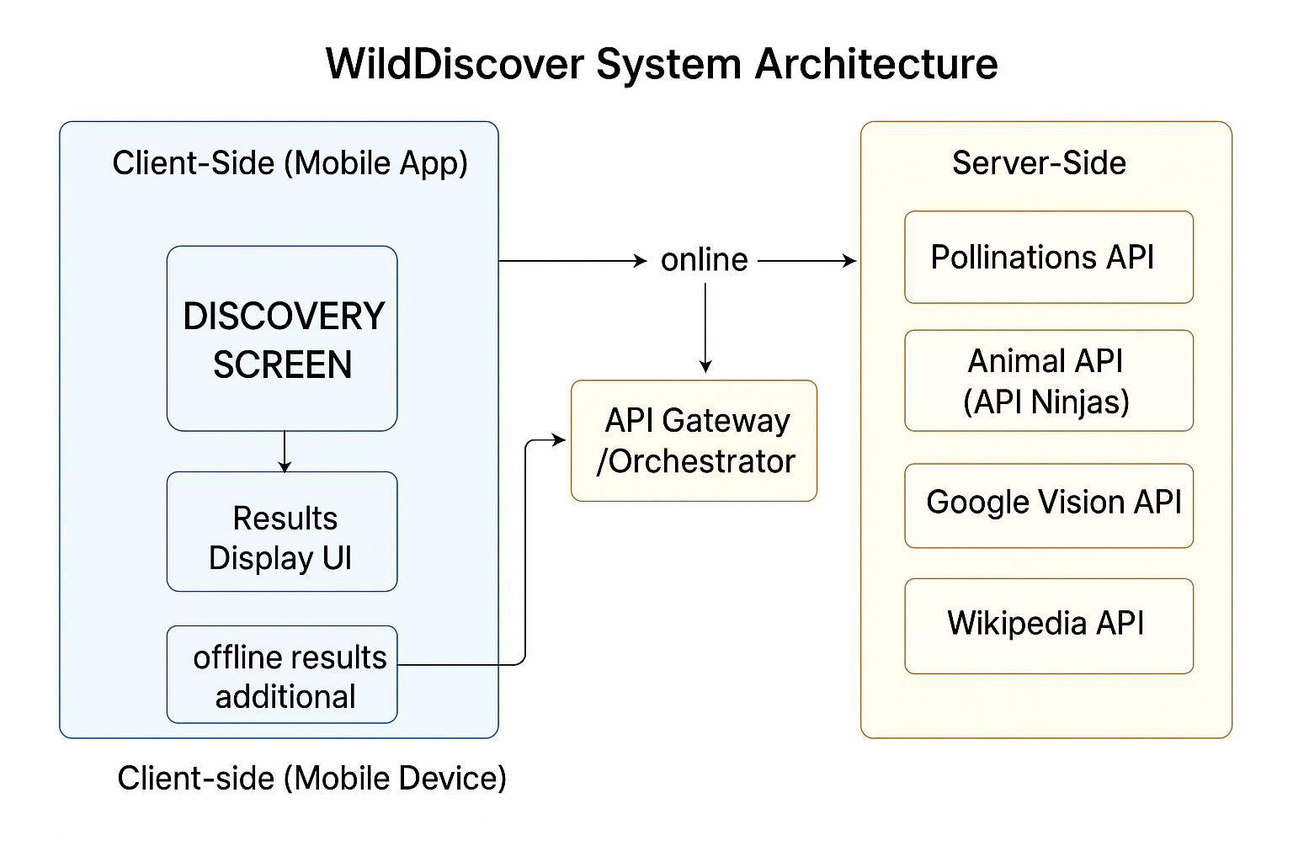
Architecture
Batch No. B14
Slide 9

Slide 10
Implementation(Step by step process)
Set up the mobile app using React Native, Flutter, or native SDKs with basic navigation.
Build the Discovery Screen with camera/gallery upload UI and trigger logic.
(Optional) Integrate an on-device ML model like TensorFlow Lite with EfficientNet.
Create a Results UI component to display identification output and cached fallback data.
Implement API communication using Axios or fetch to send image/metadata to the backend.
Batch No. B14
Slide 10

Slide 11
Implementation(Step by step process)
Set up an API Gateway using Node.js, Flask, or a similar backend framework.
Route incoming requests to Pollinations, Animal API, Google Vision, and Wikipedia based on content type.
Aggregate and normalize responses from APIs into a unified JSON format.
Implement offline fallback with a local database or embedded JSON of common species.
Test the full system using both live and mock data in online and offline conditions.
Batch No. B14
Slide 10

Slide 12
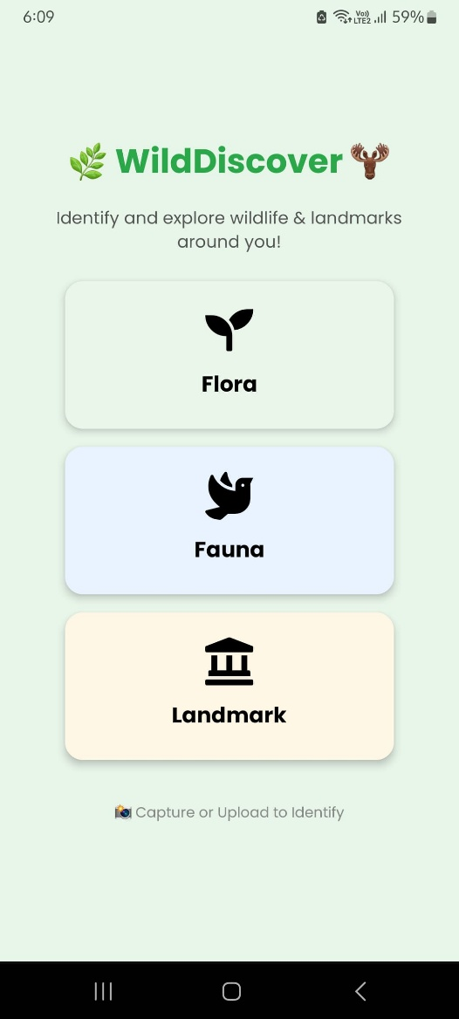
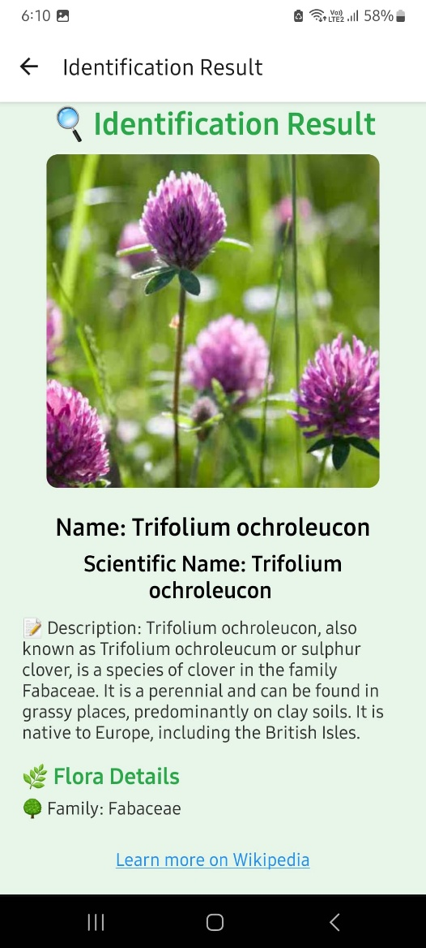
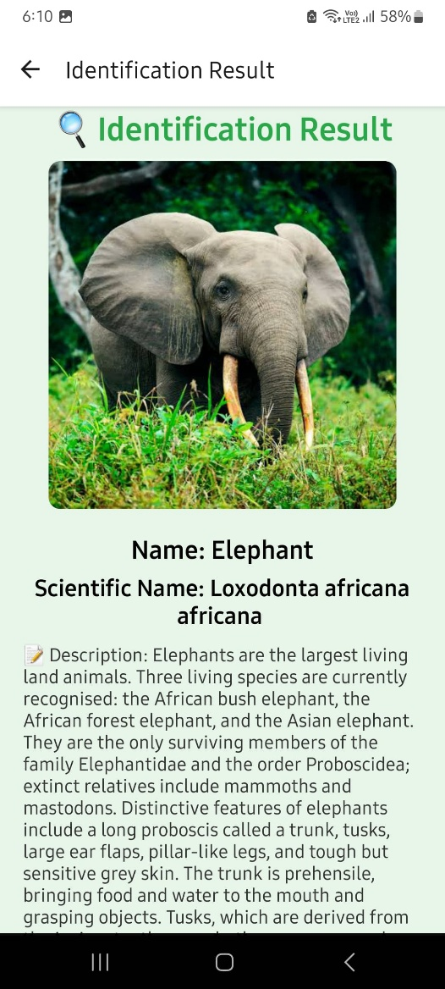
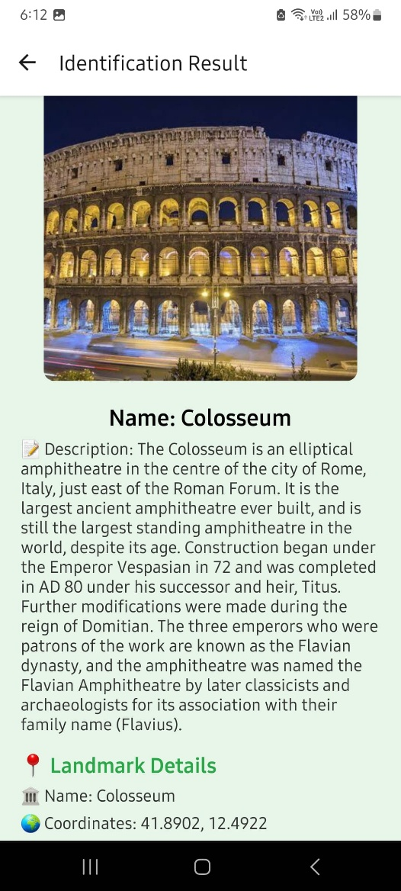
Result and Discussion
Batch No. B14
Slide 11

Slide 13
Result and Discussion
The WildDiscover system successfully enabled users to capture or upload images and receive accurate identification results for wildlife and landmarks. The mobile app delivered a smooth user experience, while the API Gateway effectively handled requests to services like Google Vision, Animal API, and Wikipedia. The integration of offline fallback ensured basic functionality even without internet access. Deployment on Firebase confirmed stable performance across Android and iOS devices, validating the system’s end-to-end workflow.
The project demonstrated that a modular architecture combining external APIs with a user-friendly interface can simplify complex identification tasks. While the system performed well, reliance on third-party APIs highlights the need for caching and optimization to reduce latency and handle rate limits. Offline support and cross-platform design proved essential for field use. Future enhancements could include user history, geolocation-based suggestions, and improved personalization for a richer discovery experience.
Batch No. B14
Slide 12

Slide 14
References
J. Abdollahi, "Identification of Medicinal Plants in Ardabil Using Deep Learning," IEEE Conference Publication, 2022. researchgate.net
M. E. Hossain, M. A. Kabir, L. Zheng, and D. L. Swain, "Deep Learning for Wildlife Conservation and Habitat Monitoring: A Comprehensive Review," ScienceDirect, 2022. thesai.org
Sazida Binta Islam, Damian Valles, "Animal Species Recognition with Deep Convolutional Neural Networks from Ecological Camera Trap Images," Animals, Volume 13, Issue 9, Article 1526, 2023. https://www.mdpi.com/2076-2615/13/9/1526
S. B. Islam and D. Valles, "Animal Species Recognition with Deep Convolutional Neural Networks from Ecological Camera Trap Images," Animals (MDPI), vol. 13, no. 9, 2023. mdpi.com
A. Carvajal and V. R. Garcia-Colon, "Detection of Wildlife Animals Using Deep Learning Approaches: A Systematic Review," IEEE Xplore, 2022. journals.sagepub.com
Batch No. B14
Slide 13

Slide 15

Slide 14

